Slide 1
IfM Internet of Things (IoT)
The interconnection via the internet of computing devices embedded in objects within the IfM, enabling them to send and receive data.

Slide 2
IfM IoT
Applications and Systems
Data modelling
Single Board Computers
Monnit Wireless Controllers
AWS DynamoDB
IfM Sensor Manager
IoT-based sensing
IoT-based control
Monnit Mine API
Actuators
Monnit Ethernet Gateways
Monnit Wireless Sensors
Objects in the IfM

Slide 3
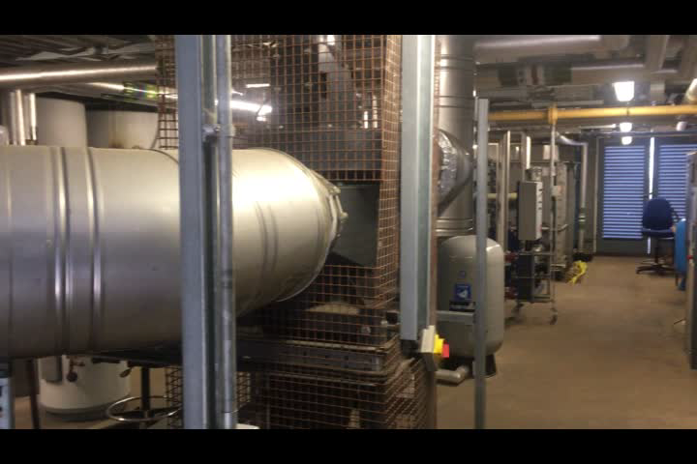

Slide 4
